Slide 1



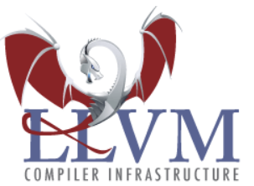



Overview of Development Environment
Target Software Stack
Common Components
Application
Application
IDE Eclipse/Platform IO base
FreeRTOS or bare metal
Project Manager
Source Editor
Analyzer
Others
HAL Interface
HAL
Toolchains GCC/LLVM base
Debugger
HAL BSP
SW
Compiler
Assembler
GDB/LLDB
CORE-V-MCU
SoC
HW
CV32E40P core
Linker
Disassembler
Debug Server OpenOCD/
Embdebug
Debug
Module
On-chip peripherals
debug connection (*)
Libraries
CORE-V-MCU
Development Board
Host
Target

